Slide 1
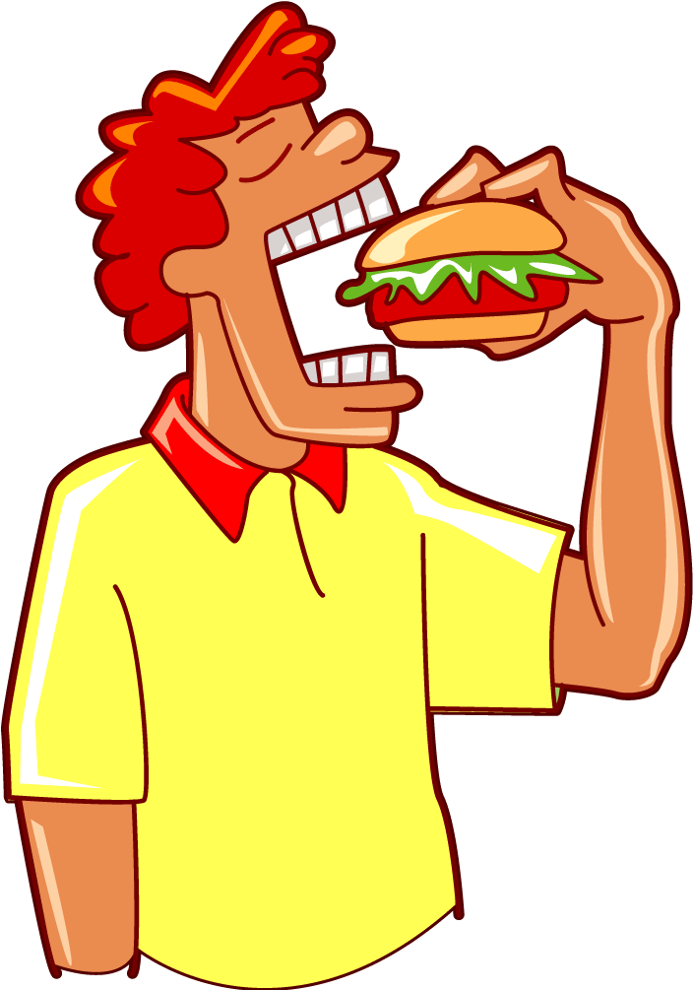


HOW MANY?
HOW MUCH?
How to talk about quantity

Slide 2
To express HOW MUCH food we have or need we use certain words called
QUANTIFIERS
But there are some differences when using
countable or
uncountable nouns
Let’s learn how to express quantity with these words.

Slide 3



LARGE AMOUNTS
countables
uncountables
How many apples are there?
How much meat is there?
There are __________________apples.
There is _________________meat.
a lot of (lots of)
a lot of (lots of)
a lot of (lots of) is used in affirmative sentences.

Slide 4
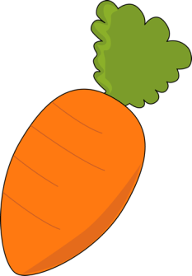
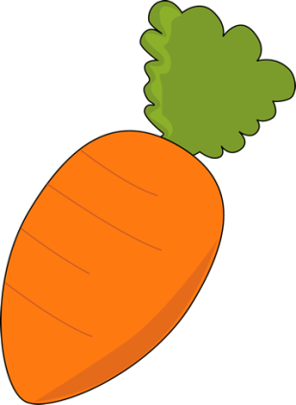
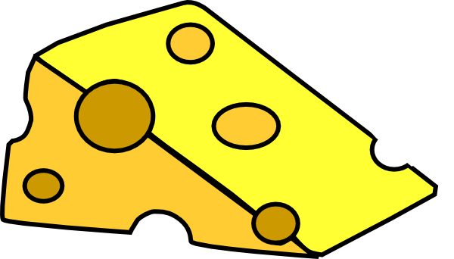
SMALLER AMOUNTS (1)
countables
uncountables
How many carrots are there?
How much cheese is there?
There are __________________carrots.
There is __________________cheese.
some /a few
some / a little
some/a few/a little have a positive meaning.

Slide 5
SMALLER AMOUNTS (2)
countables
uncountables
How many carrots are there?
How much cheese is there?
There aren’t
__________________carrots.
There isn’t
__________________cheese.
many
much
not many / not much have a negative meaning.

Slide 6


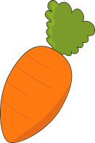
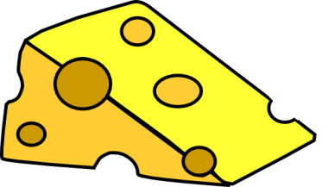
SMALLER AMOUNTS (3)
countables
● some = a few
positive meaning
● not many = few
negative meaning
uncountables
● some = a little
positive meaning
● not much = little
negative meaning

Slide 7

SINGLE AMOUNT
countables
uncountables
How many hot dogs are there?
How much milk is there?
There is only __________________hot dog.
There is _________________milk.
a (one)
a (one)
a(n), one, two… can’t be used with uncountables.
We need to use a container: There is a glass of milk.

Slide 8



NO AMOUNT
countables
uncountables
How many doughnuts are there?
How much bread is there?
There aren’t __________________doughnuts.
There isn’t __________________bread.
any
any
not any = no “There are no doughnuts/There is no bread.”

Slide 9

SOME and ANY
some
affirmatives
● There are some eggs in the fridge.
● Do you want some eggs? (for offers, requests…)
● Did you buy some eggs? (for questions where the expected answer is “yes”)
questions
any
negatives
● There aren’t any eggs in the fridge.
questions
● Have you got any eggs? (for open questions – the answer can be “yes” or “no”)

