Slide 1


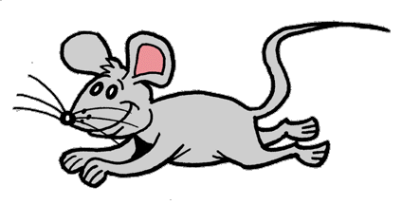
Articles

Slide 2
There are 2 kinds of articles:
Definite Articles: The
Indefinite Articles: A/An
Rule #1
When an object is being introduced for the 1st time, we use an indefinite Article (“a” or “an”) before it.
After the object has been introduced, we then use a definite Article (“the”) to talk about it.

Slide 3
There are 2 indefinite articles:
A
An
Vowels
A E I O U
Rule #2
When the object we are talking about starts with a vowel (ex: ant, octopus, elephant) we use “an”. When the object does not start with a vowel (ex: dog, bunny, girl), we use “a”.

Slide 4


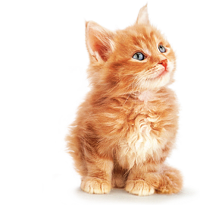

“I see ___ cat!”
a
The
“____ cat is orange.”

Slide 5

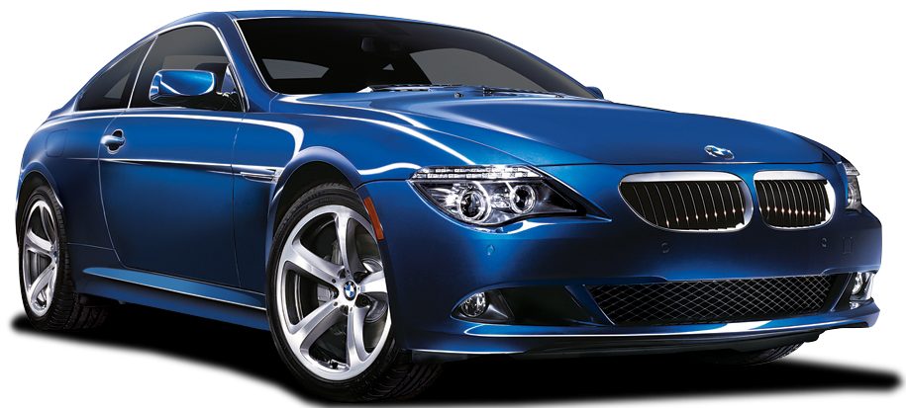
“I see ___ car!”
a
“____ car is blue.”
The

Slide 6

“I see ___ owl!”
an
The
“____ owl is brown.”

Slide 7
“I see ___ eagle!”
an
“____ eagle is very big.”
The

Slide 8
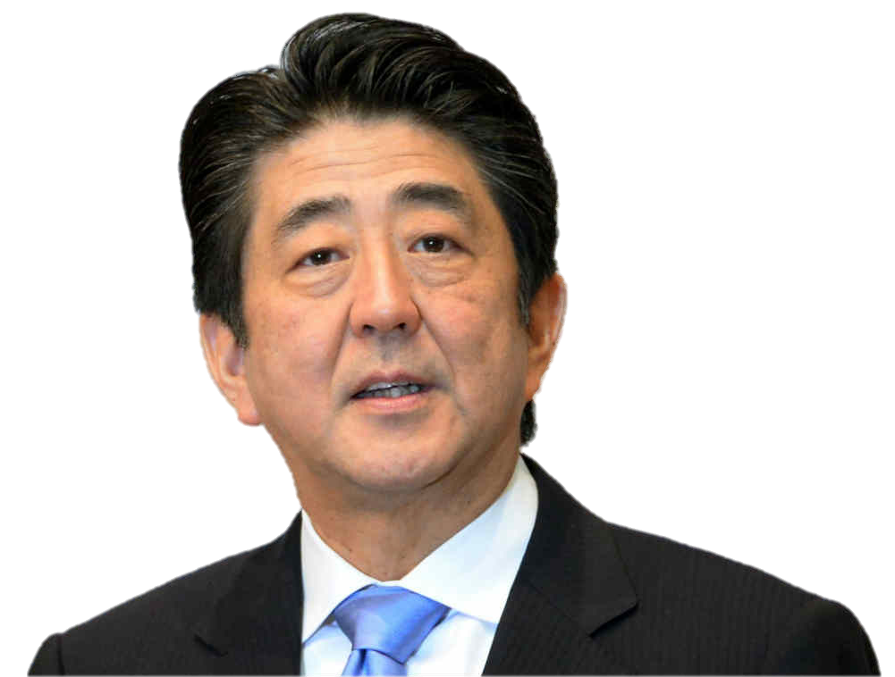
Rule #3
When the object we are talking about is unique, we always use the definite article (“the”).
Example
“____ Prime Minister of Japan is a very good public speaker.”
The

Slide 9
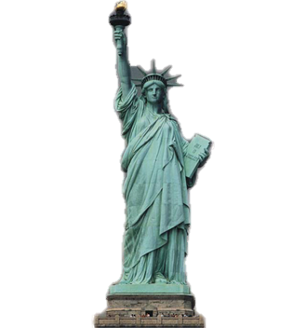
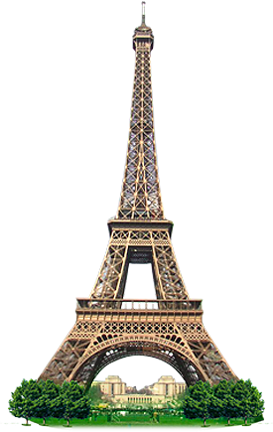
“____ Sun is very hot today.”
The
“____ Statue of Liberty is very large.”
The
“____ Eiffel Tower is beautiful.”
The

Slide 10

Story Time
I saw ___ cat.
a
The
___ cat was sitting on
a
___ fence.
The
___ fence was painted
brown.
___ cat jumped off ___ fence
The
the
when it saw ___ mouse.
a
___ mouse
The
ran into ___ hole when it saw ___ cat,
a
the
the
the
so ___ cat didn't catch ___ mouse.
Later that day, ___ owl ate the mouse.
an

